Slide 1
BARRIERS TO COMMUNICATION

Slide 2

A Barrier

Slide 3
What are Barriers to Communication?
Barriers to communication mean obstacles to the process of communication.
Communication barriers are the problems that arise at every stage of the communication process and have the potential to create misunderstanding and confusion.
Communication, when it is impeded and does not reach the receiver is often somewhat ineffective and the impediments are known as barriers.”
These barriers to communication are specific items that can distort or prevent communication within an organization.

Slide 4
Types of Barriers
Physical
Linguistic
Semantic
Communication Skills
Psychological
Socio-Cultural

Slide 5
Physical Barriers
Physical barrier is the environmental and natural condition that act as a barrier in communication in sending message from sender to receiver. Organizational environment or interior workspace design problems, technological problems and noise are the parts of physical barriers.
A physical barrier to communication can be defined as an element or a physical factor that acts as a distraction to hinder the flow of communication. A physical barrier can be natural or human-made and is easy to spot. Noise, bad architecture and closed doors are all physical barriers to listening. Even a network disturbance due to a thunderstorm can be considered as one of the examples of physical barrier.

Slide 6
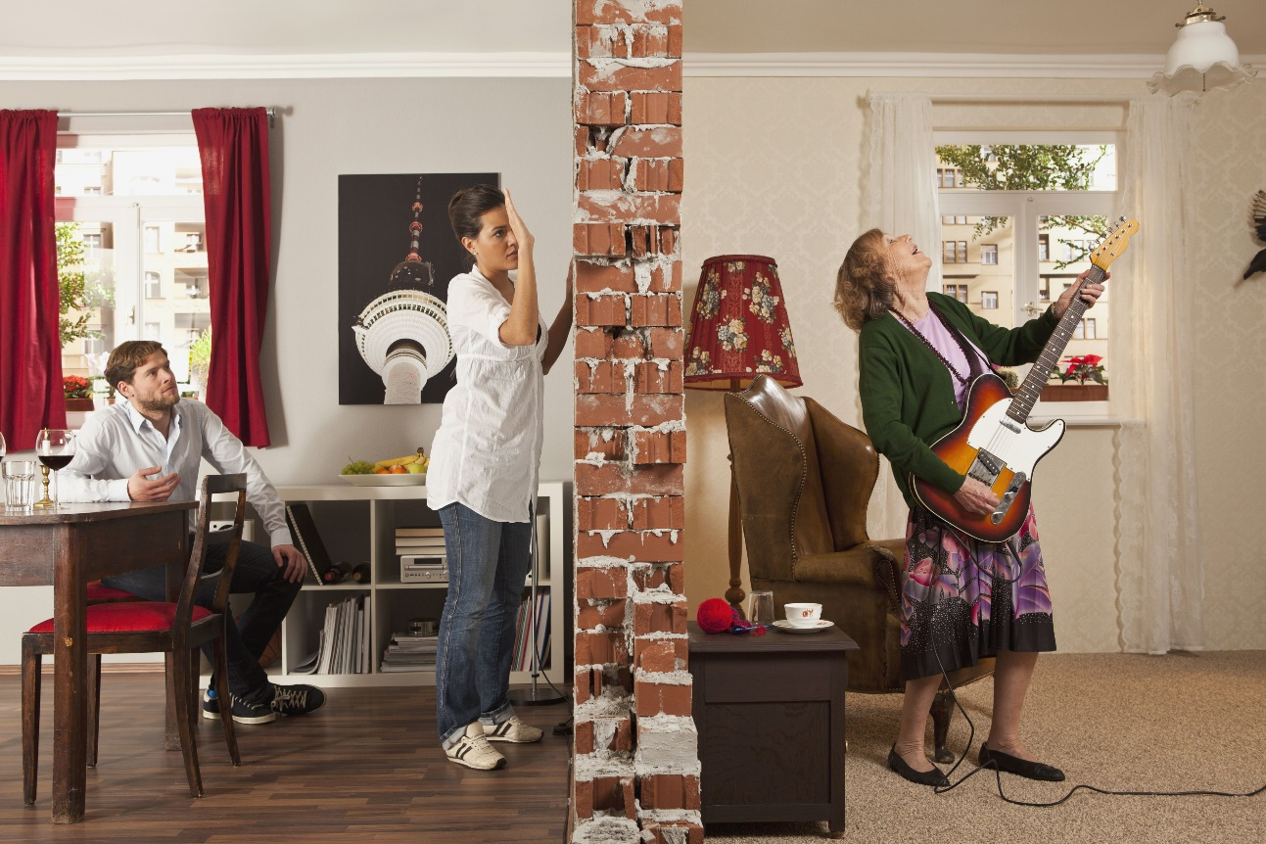

Slide 7



Slide 8
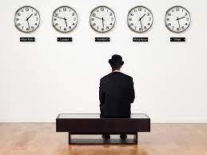
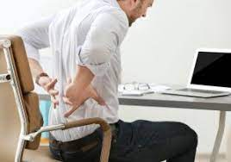

Slide 9
Common Physical Barriers
Noise
Disturbance in the environment
Traffic, construction, uncooperative crowd
Climate/Weather
Thunder, rain, wind
Heat, Cold, Lack of Sunlight
Time
Different time zones
Suitability of time
Unpleasant temperature
Distance
Physical distance between the sender and receiver

Slide 10
Common Physical Barriers
Technical Problems/Medium Disturbance
Malfunctioning equipment (computers, projectors, microphones, headphones, applications)
Architecture/Room Design
Distance, seating arrangements, quality of furniture, lighting
Internet speed and connection problems
Colors, decoration, acoustics

Slide 11
Linguistic Barriers
Linguistic barrier is any problem or obstacle arising in communication due to language use.
A language barrier is any linguistic limitation that creates confusion or prevents comprehension.

Slide 12
Common Linguistic Barriers
General language Command/Proficiency (grammar, spelling, syntax, vocabulary)
Foreign Language
Command on dialects/pidgins used (vocabulary differences)
Command on Accent (pronunciation)
Technical language/jargon
Speech and writing difference
Command on Language variety (formal, informal)

Slide 13
Semantic Barriers
Semantic barriers refer to the obstacles caused in encoding Opens in new window and decoding process due to problems with the interpretation of meanings.
The Semantic Barriers refers to the misunderstanding between the sender and receiver arising due to the different meanings of words, and other symbols used in the communication.

Slide 14
Common Semantic Barriers
Using ambiguous words (words with multiple meanings)
Multiple denotative meanings
Connotative meaning
Bypassing (people having different concepts/meanings associated with certain words)
Inference and implication
Concrete versus abstract words

Slide 15
Psychological Barriers
Psychological barriers arise in the mind.
Psychological barriers refer to the internal belief of a person that stops him from effectively completing a task. It also refers to the emotions, opinions, and status consciousness of an individual and has a direct impact on his ability to communicate with others in a positive frame of mind.

Slide 16
Common Psychological Barriers
Perceptions/Worldviews/Ideologies
Self-image/Self-esteem/Complexes
Ego
Emotional State
Lack of interest/Boredom
Prejudice/Bias
Lack of trust
Negative/Hostile attitudes/Halo effect/Stereotypes
Selective attention

Slide 17
Socio-Cultural Barriers
Socio-cultural barriers are man-made constructs originating from social norms and cultural values. They have mainly an adverse impact on information seeking by restricting access to information sources and giving rise to negative emotions.
Culture is a way of life and every culture has its own norms for social interaction and communication.
People belonging to different cultures may face a socio-cultural barrier owing to different communication norms and practices.

Slide 18
Socio-Cultural Barriers
Concept of time
Assumptions about social strata and caste system
Etiquettes
Privileged and marginalized groups
Values
Concept of Space/Proximity
Gender rules

Slide 19
Poor Communication Skills
No knowledge of the principles of Effective Communication.

Slide 20
Overcoming Barriers
Treating communication as a tool or problem solving activity.
Not taking communication for granted.
Self-knowledge and awareness
Audience analysis
Context analysis
Plan B’s for technical physical barriers (especially technical)
Using the 7 Cs of Communication
Being friendly, respectful, and thoughtful
Appropriate non-verbal communication
Being open and progressive
Emotional regulation

